Slide 1
COMPLETE
INTEROPERABILITY
FOR CAD & BIM inWEBTM
SDKs for professional software development

Slide 2
ABOUT ODA
since
1200
85%
100%
1998
Member companies worldwide
Revenue to R&D
Transparent pricing & free tech support
Experienced development team

Slide 3
ODA PLATFORM
Formats & Technologies

Slide 4
Visit Core Package page
FORMATS
TECHNOLOGIES

Slide 5
RETROSPECTIVE ROADMAP
2023
2022
EXTENSION
Start MCAD SDK Development
2021
EXTENSION
Start Scan-to-Bim Development
2019
CORE
Start ODA Constraints Engine Development
2018
CORE
New product IFC SDK
EXTENSION
EXTENSION
New LandXML support
New product BimNv SDK for Navisworks files
CORE
CORE
New product STEP SDK
New RCS point cloud engine
CORE
Start ODA Solid Modeler Development

Slide 6
FORMAT AREAS
2D CAD
BIM
3D CAD
Notes:
Добавить ссылки на продуктовые страницы

Slide 7
2D CAD
CORE
DRAWINGS
DWG, DGN, DXF,
DGN, ReCap
CORE
EXTENSION
ARCHITECTURE SDK
MAP SDK
Architecture
DWG files
Autodesk®
Map 3D
EXTENSION
EXTENSION
MECHANICAL SDK
CIVIL SDK
Autodesk®
Mechanical® files
Autodesk®Civil 3D® files & LandXML

Slide 8
BIM
CORE
EXTENSION
IFC SDK
BimRv SDK
Work with any version of IFC, developed in collaboration with bSI
Work with Revit® data without dependencies on the native Revit® application
EXTENSION
EXTENSION
Scan-to-BIM SDK
BimNv SDK
Convert point cloud data to 3D BIM models
Work with Autodesk® Navisworks® files from any application

Slide 9
3D CAD
CORE
EXTENSION
EXTENSION
STEP SDK
MECHANICAL
MCAD SDK
Complete solution
for professional STEP interoperability
Autodesk®
Mechanical® files
JT, Solidworks, Inventor
and more

Slide 10
PARTNERSHIPS
STEP
OpenBIM
cityGML
IFC
GIS

Slide 11
TECHNOLOGIES
CDE
VISUALIZE
PUBLISH
EXCHANGE

Slide 12
inWEBTM
ODA
Platform
inWEB
CDE SDK
Create a new common data environment or enrich existing one with formats and functionalities from ODA
DRAWINGS
inWEB
DWG editing in web
All SDKs
available in web
Beta
Under development

Slide 13
CDE SDK
Visit CDE page
Visualize & Markup
Collaboration & Communication
Centralized Data Management
Data Integration & Interoperability
Version Control & Revision Management
Performance and Scalability
Secure Access and Permissions
Run on

Slide 14
ODA CDE SDK
Visit CDE page
Private Cloud
Quick deployment in any environment
including an isolated local network
without connecting to third-part services.
Source Code access with Founding membership.
CDE SDK includes
Web server with REST API
JavaScript library for rendering 2D and 3D files in a browser
Various auxiliary applications from the WebTools package for running various tasks on the backend

Slide 15
VISUALIZE
Visit Visualize page
Rich import possibilities with access to native properties
Multi-threaded support
Progressive mesh object for LOD support
Rich text rendering abilities
Advanced GPU effects like real-time shadows
Optimized performance

Slide 16
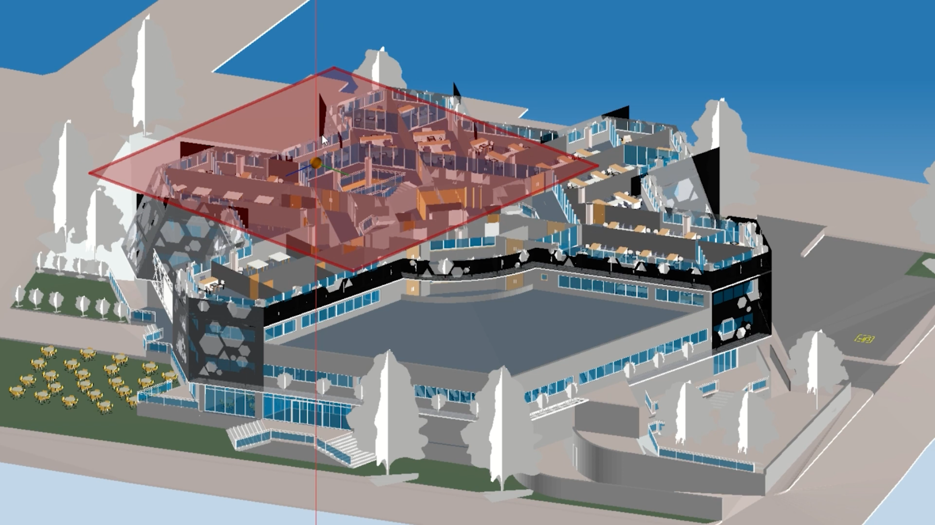
VISUALIZE
Visit Visualize page

Slide 17
PUBLISH
Visit Publish page
Publishing from CDE
Extensive Configuration Options
Complete PRC & Publish APIs
100% compatible with ISO standards and Adobe® tools
Complete 2D and 3D PDF export
Set of predefined controls for 3D publications
Publishing from all supported formats

Slide 18
EXCHANGE
Visit Exchange page
DXF
DXB
HOOPS
PDF
SVG
DWF
RVT
RFA
DAE
IFC
DWG
DWG
WMF
DAE
PDF (PRC support)
SVG
JSON
DGN
DWG
DAE
BMP
PDF (PRC support)
NWD
NWF
NWC
IFC
STEP
DWG
STL
OBJ
3D PDF
DAE
DWF
DXF
RVT
RFA
DXF
DWG
PDF (PRC support)
IFC
OBJ
BMP
STL
DWF
DWG
DXF
U3D
PRC
XTR
IFC

Slide 19
ODA MEMBERSHIP
Collaboration & Honest Pricing

Slide 20
CORE PACKAGE
EXTENSION
Key CAD & BIM formats and functionalities
for your desktop, mobile and inWEB applications
EXTENSION
EXTENSION
Notes:
Добавить ссылки на продуктовые страницы

Slide 21
CORE PACKAGE
Visit Core Package page
Notes:
Core package benefits
Includes the following:
Products: Drawings, Architecture, IFC SDKs
Functionalities: Access, Visualize, Publish, Exchange
Access to .dwg, .dgw, .dxf, point cloud data, .dwg Architecture files, various versions of IFC.
Publish to 2D and 3D pdfs
Visualize CAD and BIM data
Mature solutions for CAD & BIM
Written on cross-platform C++
.NET wrappers are available
Monthly maintenance releases

Slide 22
EXTENSIONS
Visit Extensions page
BimNv
for Navisworks files
SCAN-TO-BIM
THE ABILITY
TO CREATE A NEW EXTENSION
BimRv
for Revit files
CIVIL
Autodesk® Civil 3D® files
& LandXML
MAP
MCAD
SURVEY
STEEL
MECHANICAL
Under development
Notes:
Слово Extensions

Slide 23
MCAD SDK
Visit MCAD page
ODA is developing the industry’s first open exchange platform for 3D MCAD
Inventor
Rhino
CATIA V4
CADDS
3Shape DCM
CATIA V5
NEW
PLMXML
SolidWorks
Creo
SolidEdge
ProE
UG NX
CGR
CATIA V6
Procera
Under development

Slide 24
PRICES
& LEVELS
Notes:
Добавить ссылки на продуктовые страницы

Slide 25
PRICES
Visit Pricing page
Published pricing
no 1-on-1 negotiations
Site-based
licensing
not per-user
Prices approved
by member-
controlled board of directors

Slide 26
Commercial
Visit Pricing page
Limited commercial use
CORE
PACKAGE
Commercial distribution w/100 seat limit
Libraries, headers and examples
Documentation
C++, .NET and Java versions
Monthly releases
No affiliate or subsidiary usage
$ 3,000 First Year Cost
$ 2,250 Recurring Annual Cost

Slide 27
Sustaining
Visit Pricing page
Unlimited use+ web
CORE
PACKAGE
Everything in Commercial
Unlimited commercial distribution
Web and SaaS usage permitted
No affiliate or subsidiary usage
Full customization options
$ 7,500 First Year Cost
$ 4,500 Recurring Annual Cost

Slide 28
Visit Pricing page
Available extensions
Sustaining
BimRv SDK
$6,250
Civil SDK
$10,000
SDK for Autodesk® Revit® files
SDK for Autodesk® Civil 3D® files
BimNv SDK
Map SDK
$6,250
$10,000
SDK for Autodesk® Navisworks® files
SDK for Autodesk® Map 3D® files
Scan-to-BIM
Mechanical SDK
$20,000
$10,000
ODA is developing the industry’s first Scan-to-BIM SDK
SDK for Autodesk® Mechanical® files
MCAD SDK
$30,000
Converter for CATIA, Inventor, SolidEdge, Parasolid, Solid Works and more

Slide 29
Founding
Visit Pricing page
+ Source code
CORE
PACKAGE
Everything in Sustaining
Full source code for all products
Direct access to ODA Git repositories
Voting rights for ODA business decisions
Contact us for affiliate/subsidiary licensing
$ 37,500 First Year Cost
$ 18,000 Recurring Annual Cost

Slide 30
Visit Pricing page
Available extensions
Founding
BimRv SDK
$12,500
Civil SDK
$10,000
SDK for Autodesk® Revit® files
SDK for Autodesk® Civil 3D® files
BimNv SDK
Map SDK
$12,500
$10,000
SDK for Autodesk® Navisworks® files
SDK for Autodesk® Map 3D® files
Scan-to-BIM
Mechanical SDK
$20,000
$10,000
ODA is developing the industry’s first Scan-to-BIM SDK
SDK for Autodesk® Mechanical® files
MCAD SDK
$30,000
Converter for CATIA, Inventor, SolidEdge, Parasolid, Solid Works and more

Slide 31
SELECT FORMATS and functionalities
CALCULATE
Membership Plan

Slide 32
FOUNDING MEMBERSHIP BENEFITS
Source code page
Full source code
for all products
Direct access
to ODA Git repositories
Long-term security
Influence In ODA priorities

Slide 33
BEYOND

Slide 34
ODA CONSULTING SERVICES
Consulting Services page
Dedicated training
Proof
of concept
Available to Sustaining and higher
$ 150
Per hour
ODA-based
Software
development
Other tasks
400
max.
Consulting hours per member / per year
Work to be directed by member company

Slide 35
ODA VIEWERS
Open IFC Viewer
First to support new IFC versions and experimental IFC features from bSI
Innovative IFC viewer
Open STEP Viewer
Professional-grade STEP viewer

Slide 36
FOLLOW
US!
opendesign.com
Youtube
LinkedIn
X

Slide 37
THANK YOU!
Neil Peterson
President
npeterson@opendesign.com﻿
NeilPeterson
+1 321-301-5744
LinkedIn

